Slide 1

Performance evaluation of
GNSS/INS integration
Student: Guo Xiaoliang
Supervisor: Prof. ‪Nobuaki Kubo
2021/08/10

Slide 2
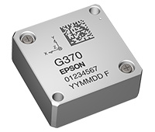

0. Contents
Objectives;
GNSS/INS loosely coupled and tightly coupled;
Multi-sensor fusion method;
Experiment and result;
Summary.
Notes:
https://global.epson.com/products_and_drivers/sensing_system/imu/g370/

Slide 3
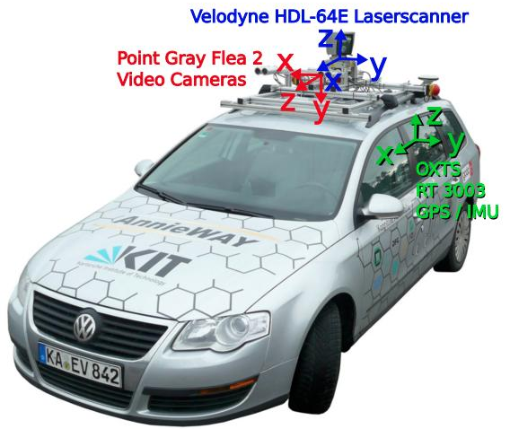
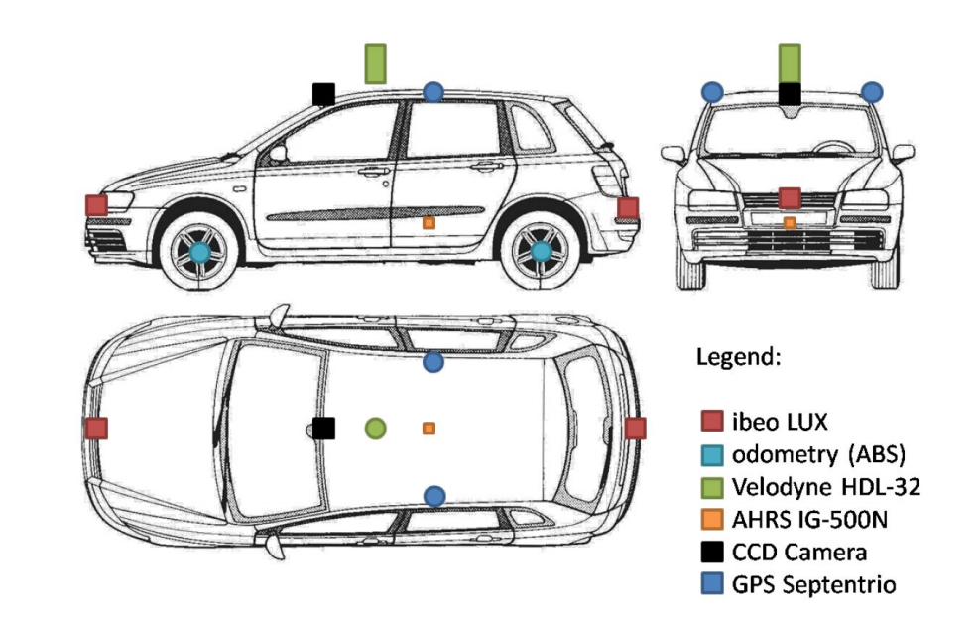
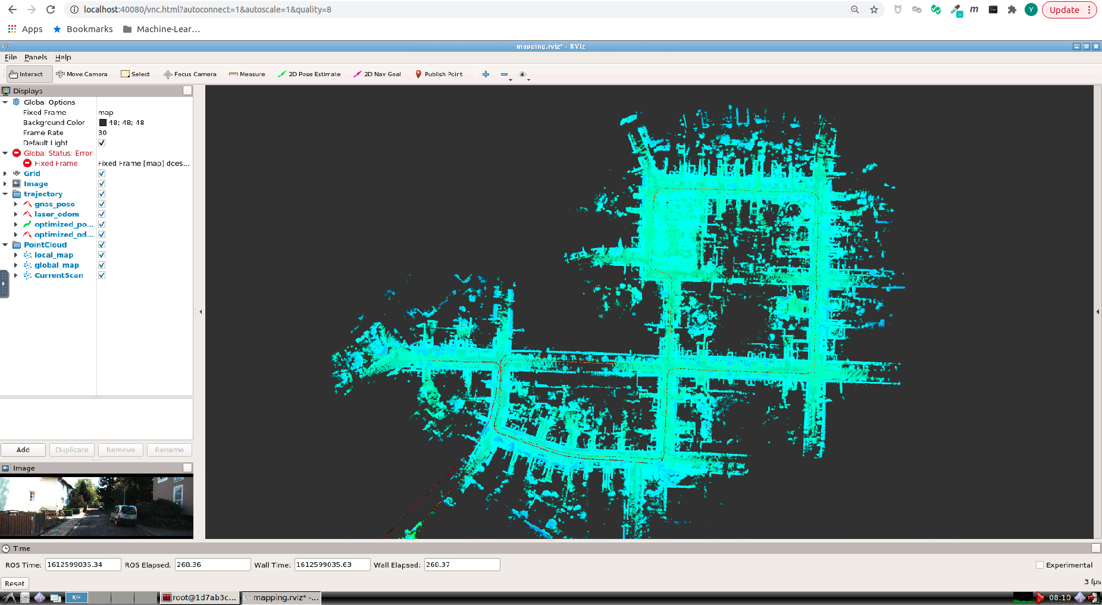
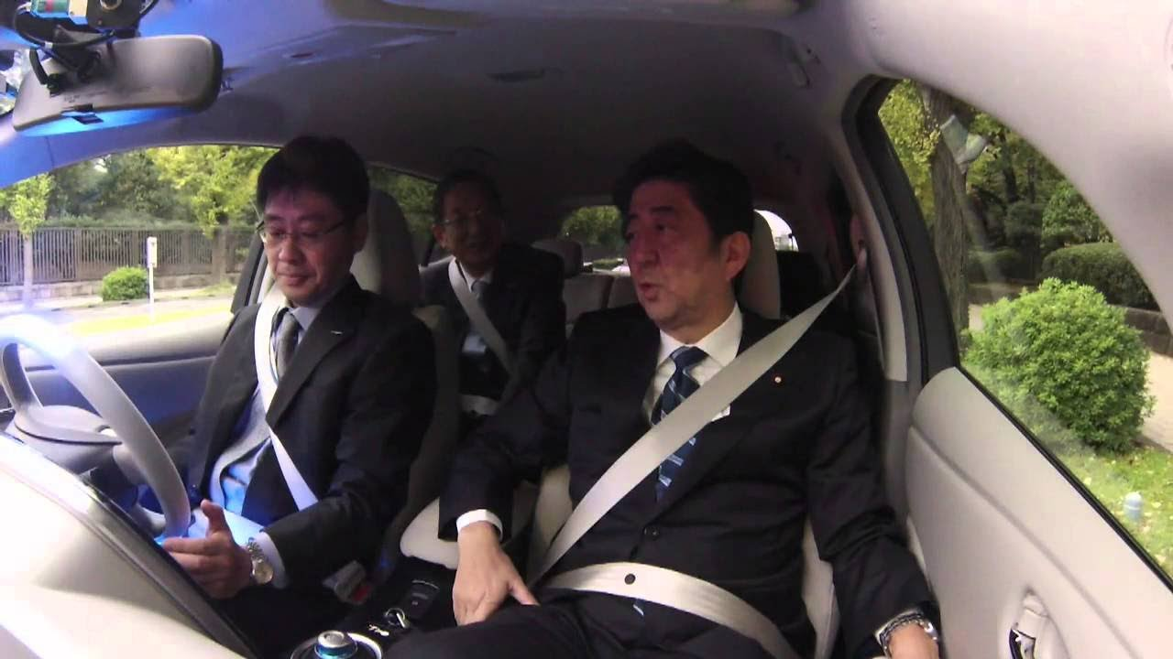
1. Objectives
With the rise of automatic driving, the research of vehicle integrated navigation and positioning becomes very important. In the face of market-oriented demand, what kind of technical solutions to achieve low-cost, high reliability and accurate positioning have become an important research topic.
Notes:
Lidar and Camera are popular in automatic driving, popularize, in SLAM, the mapping and global initialization are still based on GNSS. Also, the INS high-frequency result can optimize the positioning. GNSS/INS is the base of the positioning.
simultaneous localization and mapping

Slide 4
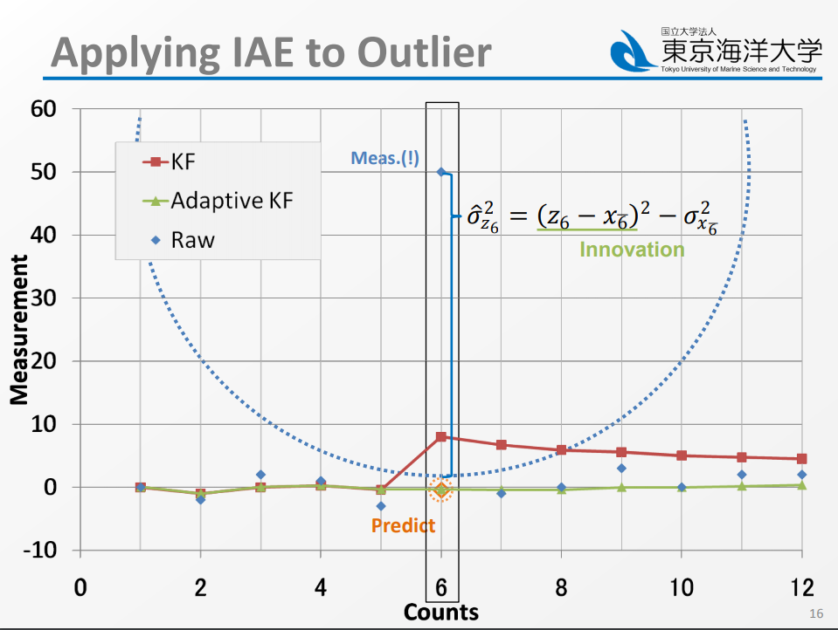
1. Objectives
Our laboratory has study in GNSS and INS for many years.
Dr. Tominaga showed the IAE (innovation-based adaptive estimation) Kalman filter, and compare the estimation result with classical Kalman filter, we continue his study, and use this method in the tightly coupled.
Reference: Takaki Tominaga, A study on improvement of GNSS positioning system in urban area
Notes:
http://www.denshi.e.kaiyodai.ac.jp/wp-content/uploads/pdf/content1/2018Tominaga.pdf
Robust Kalman filter

Slide 5
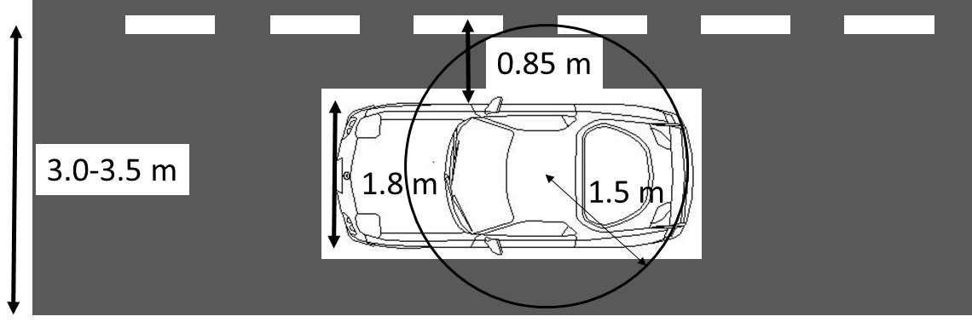
1. Objectives
Our laboratory has achieved accuracy within 1 m (95%) even in dense urban area (Marunouchi) using low-cost GNSS/IMU + speed sensor.
However, we have not investigated the difference of performance between loosely coupled (LC) and tightly coupled (TC) thoroughly. In this paper, the TC program was built and mainly focused on the difference between LC and TC.
The accuracy leaves in the TODO list and set as the future study.
Notes:
Lane level accuracy!
95 confidence interval

Slide 6
2. GNSS/INS coupled
Each sensor has its advantages and disadvantages, GNSS/INS coupled can improve the positioning better.
Kalman Filter
GNSS
INS
Advantages
Disadvantages
High precise position velocity and time
Error accumulate with time
Disadvantages
Advantages
Low frequency
Weak signal and easy to be tracked
High frequency
Local working mode
Notes:
Complement each other

Slide 7
2. GNSS/INS coupled
The difference between two methods is the measurements, tightly coupled is closer to the raw data.
Kalman Filter
GNSS
INS
Loosely coupled
Position & speed
Attitude & speed
Close to the raw data
Tightly coupled
Pseudo range
Doppler frequency
Carrier phase
Gyro x, y, z;
Acceleration x, y, z.

Slide 8
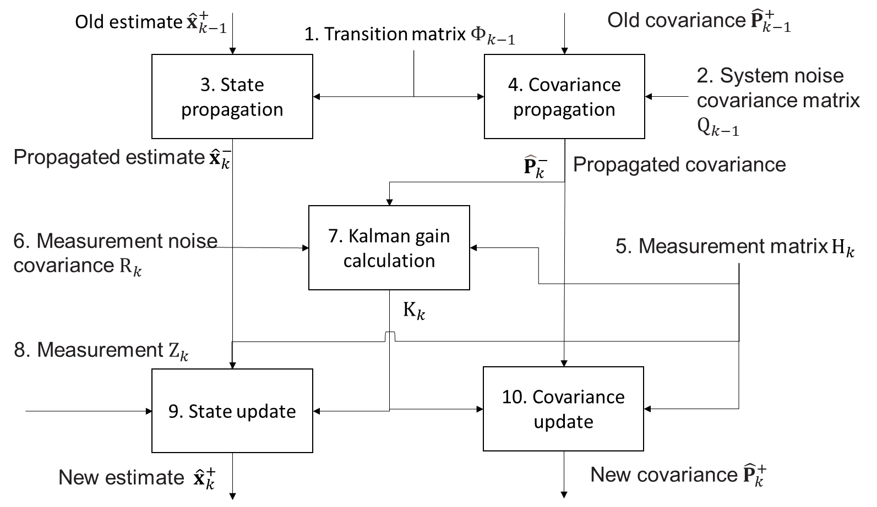
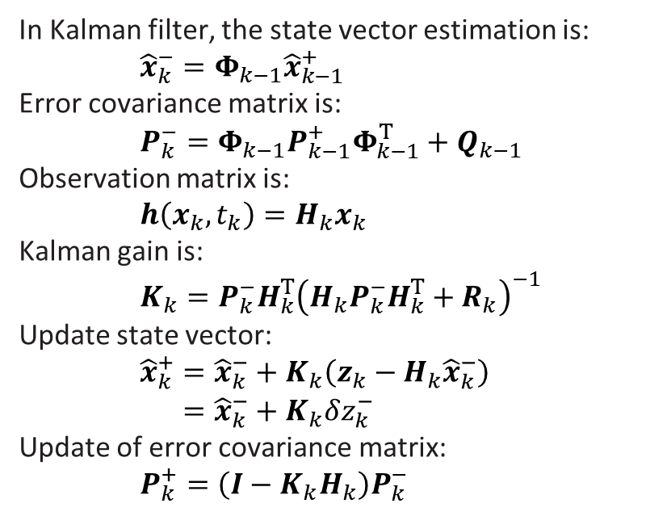
2. GNSS/INS coupled
Basic Kalman filter in GNSS/INS integration.
In Kalman filter, the state vector estimation is:
${\hat{x}}_{k}^{−}=Φ_{k−1}{\hat{x}}_{k−1}^{+}$
Error covariance matrix is:
$P_{k}^{−}=Φ_{k−1}P_{k−1}^{+}Φ_{k−1}^{T}+Q_{k−1}$
Observation matrix is:
$h\left(x_{k},t_{k}\right)=H_{k}x_{k}$
Kalman gain is:
$K_{k}=P_{k}^{−}H_{k}^{T}{\left(H_{k}P_{k}^{−}H_{k}^{T}+R_{k}\right)}^{−1}$
Update state vector:
$\begin{aligned}{\hat{x}}_{k}^{+}&={\hat{x}}_{k}^{−}+K_{k}\left(z_{k}−H_{k}{\hat{x}}_{k}^{−}\right) \\ &={\hat{x}}_{k}^{−}+K_{k}δz_{k}^{−}\end{aligned}$
Update of error covariance matrix:
$P_{k}^{+}=\left(I−K_{k}H_{k}\right)P_{k}^{−}$

Slide 9
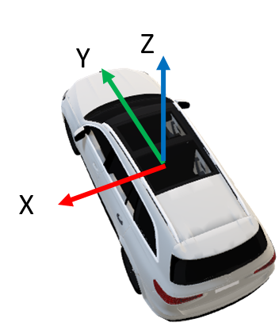
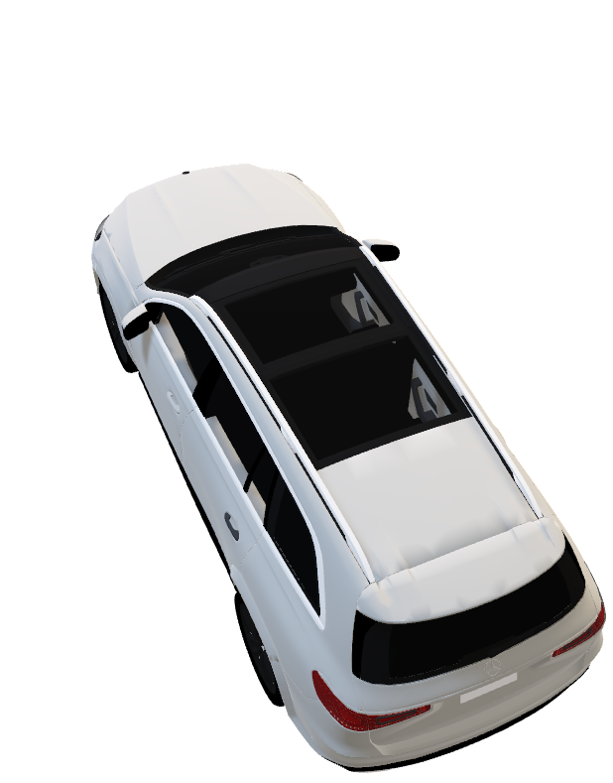
2. GNSS/INS coupled
Mechanization equation in ECEF
INS position methods called mechanization equation.
For mechanization equation, there are four steps:
Using gyro increments to update the attitude;
Convert the acceleration specific force from body frame to navigation frame (ECEF or ENU);
Using old velocity, the acceleration and the time interval, the new speed can be calculated;
The new position can be calculated from the old position, new speed and time interval.
Y
Z
3D vector
X
Notes:
Rotation and displacement

Slide 10
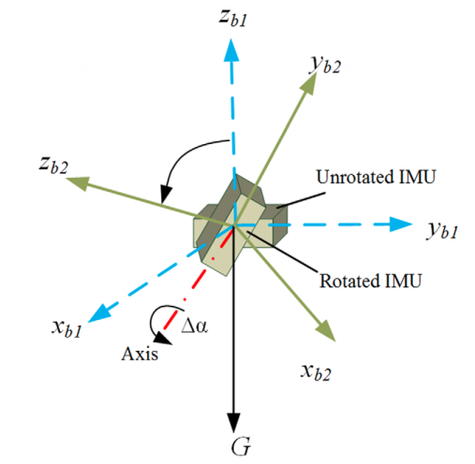
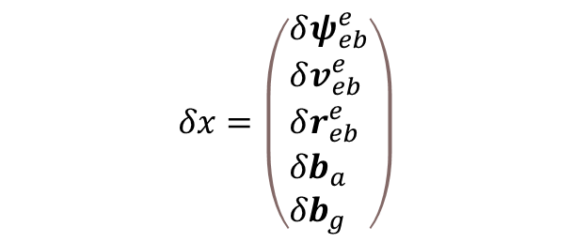
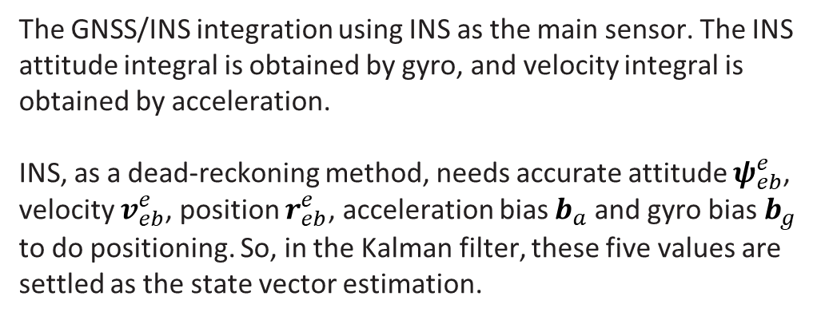
2. GNSS/INS coupled
Design Kalman filter for GNSS/INS integration
The GNSS/INS integration using INS as the main sensor. The INS attitude integral is obtained by gyro, and velocity integral is obtained by acceleration.
INS, as a dead-reckoning method, needs accurate attitude $ψ_{eb}^{e}$, velocity $v_{eb}^{e}$, position $r_{eb}^{e}$, acceleration bias $b_{a}$and gyro bias $b_{g}$ to do positioning. So, in the Kalman filter, these five values are settled as the state vector estimation.
$$δx=\left(\begin{aligned}&δψ_{eb}^{e} \\ &δv_{eb}^{e} \\ &δr_{eb}^{e} \\ &{δb}_{a} \\ &{δb}_{g}\end{aligned}\right)$$
Notes:
https://en.wikipedia.org/wiki/Integral
The process of finding integrals is called integration

Slide 11
2.1 GNSS/INS loosely coupled
GNSS
GNSS receiver Pos & vel
LC KF
Pos, vel & att
INS pos & vel
INS
INS Gyro & Acc
Strapdown
Feed back
GNSS/INS loosely coupled means using GNSS position and velocity as Kalman filter measurements, which use it to estimate the INS. The Kalman filter will feed back the INS bias and output the position, velocity and attitude.
Notes:
Derivation
Mathematical expectation

Slide 12
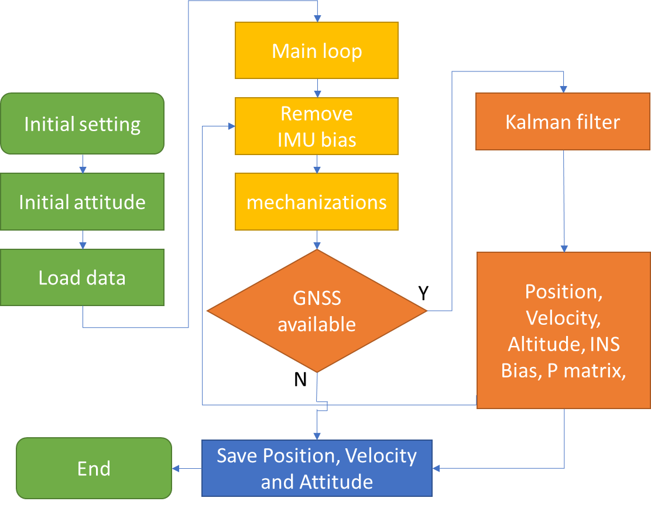
2.1 GNSS/INS loosely coupled
The GNSS/INS loosely coupled flow chart was showed in the left;
The initial attitude of INS is the Euler angle from body frame the navigation frame (ECEF);
If GNSS available, do Kalman filter. If not, output the INS result;
This program has close-loop correction, so after the Kalman filter, the estimate bias will feed back to the INS.
Notes:
https://github.com/kakusang2020/iXR_GNSS-IMU_TightlyCouplingProgram

Slide 13
2.2 GNSS/INS tightly coupled
GNSS
GNSS Pseudo range & rate
TC KF
GNSS satellite position & velocity
Pos,
vel
& att
error of INS
Pseudo range & rate
INS
INS Gyro & Acc
Strapdown
INS pos, vel & att
Pos, vel & att
Feed back
GNSS/INS tightly coupled means using GNSS pseudo range and pseudo range rate (Doppler frequency) as Kalman filter measurements, using INS position and velocity to calculate the estimate pseudo range and pseudo range rate, Kalman filter will estimate the INS errors, and eliminate the error of INS.
Notes:
Derivation

Slide 14
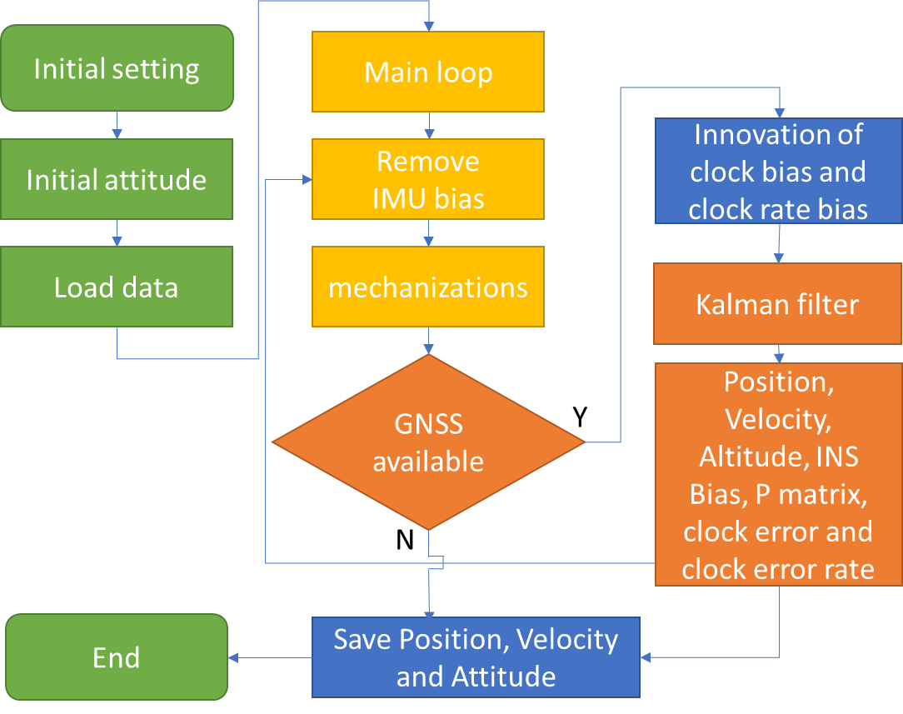
2.2 GNSS/INS tightly coupled
The GNSS/INS tightly coupled flow chart was showed in the left;
The initial attitude of INS is the Euler angle from body frame the navigation frame (ECEF);
If GNSS available, do Kalman filter. If not, output the INS result;
This program has close-loop correction, so after the Kalman filter, the estimate bias will feed back to the INS.
Notes:
https://global.epson.com/products_and_drivers/sensing_system/imu/g370/

Slide 15



2.3 Difference with LC & TC
The difference between loosely coupled and tightly coupled is:
When the number of the satellites is less than 4, loosely coupled can’t provide the measurements, but the tightly coupled can continuously provide the measurements when the satellites is one or more.
The satellite position, Ionospheric delay tropospheric delay are as the known quantity, we just need to estimate the receiver clock error and clock error rate.
It means that the tightly coupled can provide more continue measurement than loosely coupled. When the GNSS receiver in the urban environment, tightly coupled result should be more stable than loosely coupled.
$$P_{(m)}=ρ+c(δT−δt)+δ_{\text{ion} }+δ_{\text{trop} }+ε_{\text{r} }$$
TC
blocked
blocked
blocked
LC
Even in this case (only 1 sat.), TC can compare the measurement pseudo-range with predicted pseudo-range through INS.
Notes:
The satellite position, Ionospheric delay tropospheric delay and the reality correction are as the known quantity, we just need to estimate the receiver clock error and error rate.
Relativistic correction

Slide 16
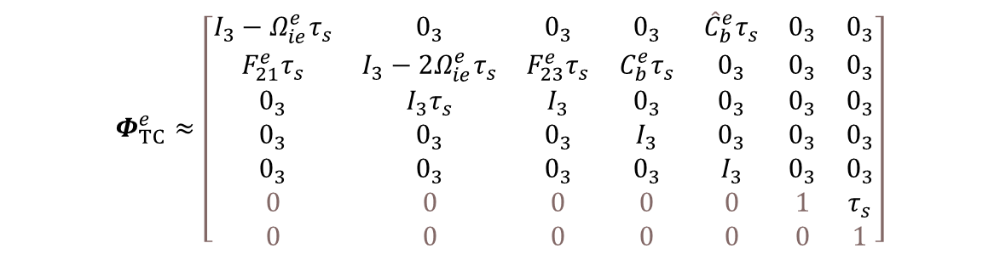
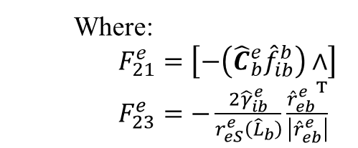
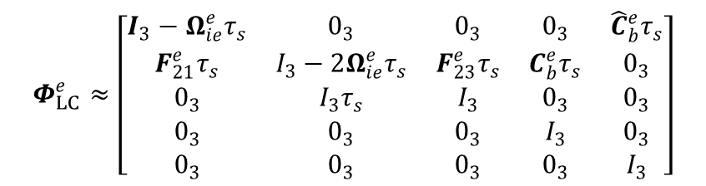
2.3 Difference with LC & TC
The difference of transformation matrix is as follows:
$$Φ_{TC}^{e}≈\left[\begin{matrix}I_{3}−Ω_{ie}^{e}τ_{s} & 0_{3} & 0_{3} & 0_{3} & {\hat{C}}_{b}^{e}τ_{s} & 0_{3} & 0_{3} \\ F_{21}^{e}τ_{s} & I_{3}−2Ω_{ie}^{e}τ_{s} & F_{23}^{e}τ_{s} & C_{b}^{e}τ_{s} & 0_{3} & 0_{3} & 0_{3} \\ 0_{3} & I_{3}τ_{s} & I_{3} & 0_{3} & 0_{3} & 0_{3} & 0_{3} \\ 0_{3} & 0_{3} & 0_{3} & I_{3} & 0_{3} & 0_{3} & 0_{3} \\ 0_{3} & 0_{3} & 0_{3} & 0_{3} & I_{3} & 0_{3} & 0_{3} \\ 0 & 0 & 0 & 0 & 0 & 1 & τ_{s} \\ 0 & 0 & 0 & 0 & 0 & 0 & 1\end{matrix}\right]$$
$$Φ_{LC}^{e}≈\left[\begin{matrix}I_{3}−Ω_{ie}^{e}τ_{s} & 0_{3} & 0_{3} & 0_{3} & {\hat{C}}_{b}^{e}τ_{s} \\ F_{21}^{e}τ_{s} & I_{3}−2Ω_{ie}^{e}τ_{s} & F_{23}^{e}τ_{s} & C_{b}^{e}τ_{s} & 0_{3} \\ 0_{3} & I_{3}τ_{s} & I_{3} & 0_{3} & 0_{3} \\ 0_{3} & 0_{3} & 0_{3} & I_{3} & 0_{3} \\ 0_{3} & 0_{3} & 0_{3} & 0_{3} & I_{3}\end{matrix}\right]$$
Where:
$F_{21}^{e}=\left[−\left({\hat{C}}_{b}^{e}{\hat{f}}_{ib}^{b}\right)∧\right]$
$F_{23}^{e}=−\frac{2{\hat{γ}}_{ib}^{e}}{r_{eS}^{e}\left({\hat{L}}_{b}\right)}\frac{{{\hat{r}}_{eb}^{e}}^{T}}{\left|{\hat{r}}_{eb}^{e}\right|}$
Reference: Paul D Groves, Principles of GNSS, Inertial, and Multisensor Integrated Navigation Systems
Notes:
The satellite position, Ionospheric delay tropospheric delay and the reality correction are as the known quantity, we just need to estimate the receiver clock error and error rate.
Relativistic correction

Slide 17
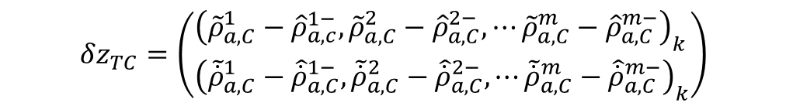
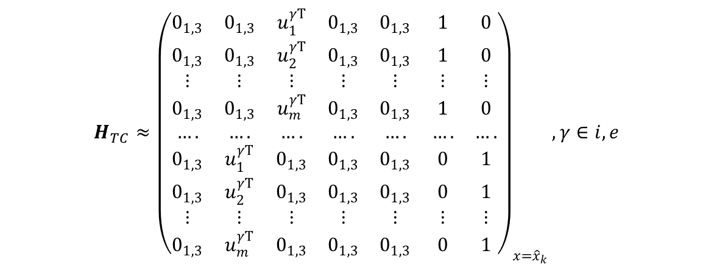
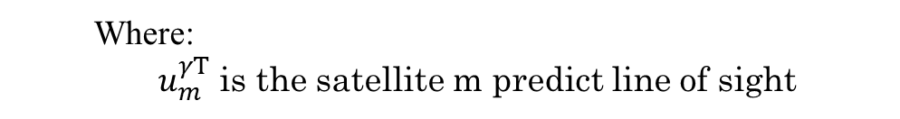
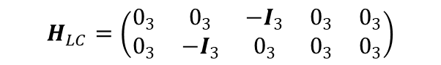

2.3 Difference with LC & TC
The difference in observation matrix is as follows:
$$H_{TC}≈{\left(\begin{matrix}0_{1,3} & 0_{1,3} & u_{1}^{γT} & 0_{1,3} & 0_{1,3} & 1 & 0 \\ 0_{1,3} & 0_{1,3} & u_{2}^{γT} & 0_{1,3} & 0_{1,3} & 1 & 0 \\ ⋮ & ⋮ & ⋮ & ⋮ & ⋮ & ⋮ & ⋮ \\ 0_{1,3} & 0_{1,3} & u_{m}^{γT} & 0_{1,3} & 0_{1,3} & 1 & 0 \\ …. & …. & …. & …. & …. & …. & …. \\ 0_{1,3} & u_{1}^{γT} & 0_{1,3} & 0_{1,3} & 0_{1,3} & 0 & 1 \\ 0_{1,3} & u_{2}^{γT} & 0_{1,3} & 0_{1,3} & 0_{1,3} & 0 & 1 \\ ⋮ & ⋮ & ⋮ & ⋮ & ⋮ & ⋮ & ⋮ \\ 0_{1,3} & u_{m}^{γT} & 0_{1,3} & 0_{1,3} & 0_{1,3} & 0 & 1\end{matrix}\right)}_{x={\hat{x}}_{k}},γ∈i,e$$
$$H_{LC}=\left(\begin{matrix}0_{3} & 0_{3} & −I_{3} & 0_{3} & 0_{3} \\ 0_{3} & −I_{3} & 0_{3} & 0_{3} & 0_{3}\end{matrix}\right)$$
The difference in innovation matrix is as follows:
$$δz_{LC}={\left(\begin{aligned}&{\hat{r}}_{eaG}^{e}−{\hat{r}}_{eb}^{e}−{\hat{C}}_{b}^{e}L_{ba}^{b} \\ &{\hat{v}}_{eaG}^{e}−{\hat{v}}_{eb}^{e}−{\hat{C}}_{b}^{e}\left({\hat{ω}}_{ib}^{b}∧L_{ba}^{b}\right)+Ω_{ie}^{e}{\hat{C}}_{b}^{e}L_{ba}^{b}\end{aligned}\right)}_{k}$$
$$δz_{TC}=\left(\begin{aligned}&{\left({\tilde{ρ}}_{a,C}^{1}−{\hat{ρ}}_{a,c}^{1−},{\tilde{ρ}}_{a,C}^{2}−{\hat{ρ}}_{a,C}^{2−},⋯{\tilde{ρ}}_{a,C}^{m}−{\hat{ρ}}_{a,C}^{m−}\right)}_{k} \\ &{\left({\tilde{\dot{ρ}}}_{a,C}^{1}−{\hat{\dot{ρ}}}_{a,C}^{1−},{\tilde{\dot{ρ}}}_{a,C}^{2}−{\hat{\dot{ρ}}}_{a,C}^{2−},⋯{\tilde{\dot{ρ}}}_{a,C}^{m}−{\hat{\dot{ρ}}}_{a,C}^{m−}\right)}_{k}\end{aligned}\right)$$
Where:
$u_{m}^{γT}$ is the satellite m predict line of sight
Reference: Paul D Groves, Principles of GNSS, Inertial, and Multisensor Integrated Navigation Systems
Notes:
The satellite position, Ionospheric delay tropospheric delay and the reality correction are as the known quantity, we just need to estimate the receiver clock error and error rate.
Relativistic correction
Principles of GNSS, Inertial, and Multisensor Integrated Navigation Systems Paul D Groves

Slide 18



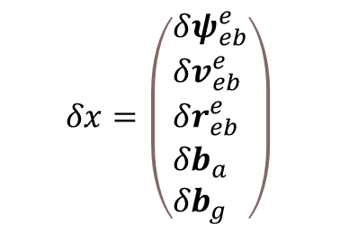
3. Multi-sensor fusion method
Besides using GNSS position and velocity, there are several choices for Kalman filter measurements, for the attitude $ψ_{eb}^{e}$, velocity $v_{eb}^{e}$, position $r_{eb}^{e}$, acceleration bias $b_{a}$and gyro bias $b_{g}$, the measurements are as follows:
$$δv_{eb}^{e}$$
$$δx=\left(\begin{aligned}&δψ_{eb}^{e} \\ &δv_{eb}^{e} \\ &δr_{eb}^{e} \\ &{δb}_{a} \\ &{δb}_{g}\end{aligned}\right)$$
Vehicle motion model , Wheel speed sensor
$$δr_{eb}^{e}$$
Barometer
$${δb}_{g}$$
Zero angular rate update
Notes:
When the vehicle is driving on the road, the vertical speed is 0

Slide 19
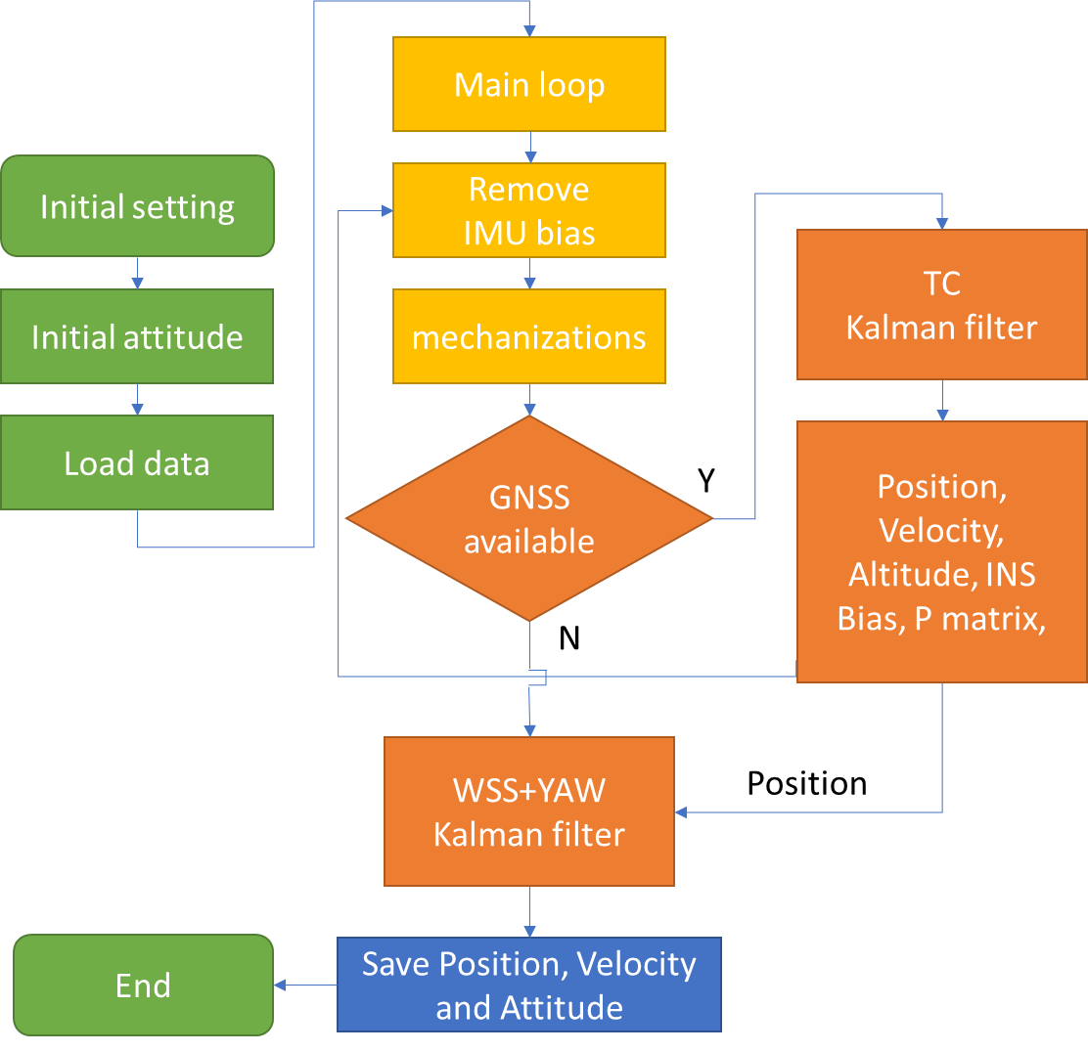
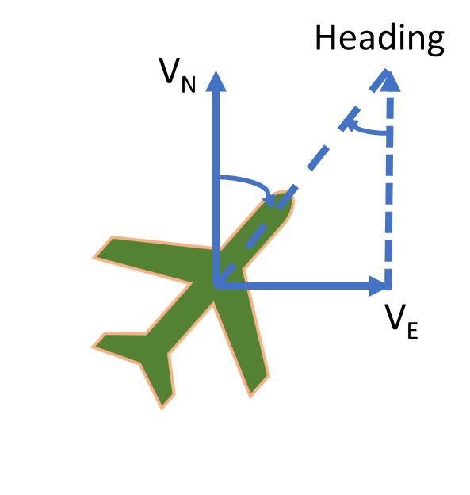
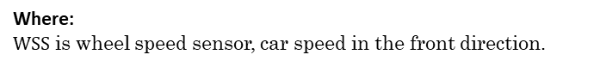
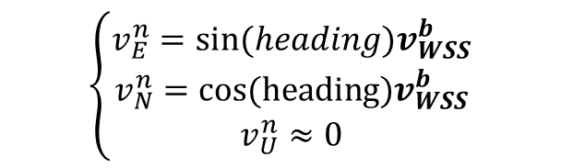
3.1 Wheel speed sensor
$$\left\{\begin{matrix}v_{E}^{n}={sin(heading)v}_{WSS}^{b} \\ \begin{aligned}v_{N}^{n}=cos(heading)v_{WSS}^{b} \\ v_{U}^{n}≈0\end{aligned}\end{matrix}\right.$$
For the vehicle motion model, in the ENU coordination, the vertical velocity is zero. The horizontal velocity is the component of the forward velocity of the body coordinate in the East and north directions.
Where:
$WSS$is wheel speed sensor, car speed in the front direction.
Notes:
https://global.epson.com/products_and_drivers/sensing_system/imu/g370/

Slide 20
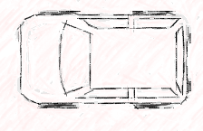
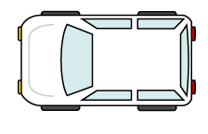
3.1 Wheel speed sensor
The WSS+YAW can provide the velocity in ENU. Using old position and velocity, we can get the WSS+YAW dead-reckoning position, do Kalman filter with the LC/TC position, can remove some error from the GNSS.
The Kalman filter is a very simple filter, the WSS+YAW error covariance is set as 0.1 m, the LC/TC position error covariance is set as 1 m.
The WSS+YAW dead-reckoning position has accumulate error because of the speed and the YAW angle. So the position accuracy can’t hold in a long time.
LC/TC
WSS+YAW
North
YAW
New position
(Kalman filter result)
East
Old position

Slide 21
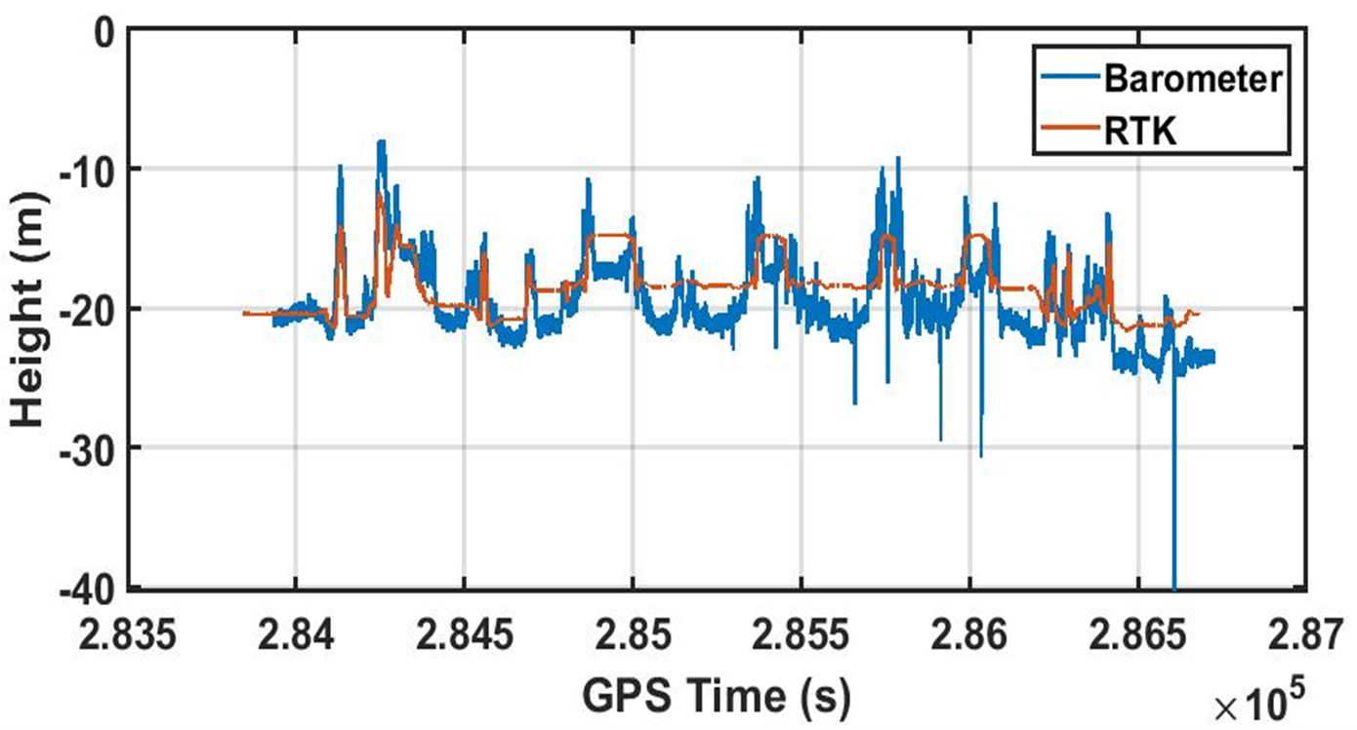
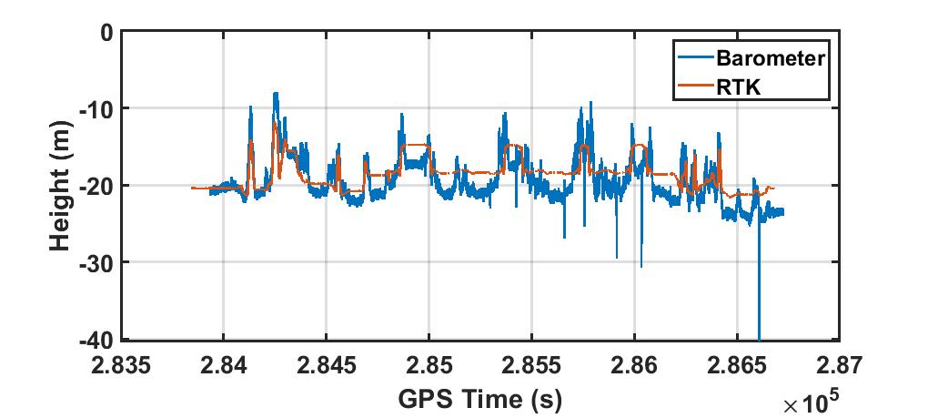

3.2 Barometer
Barometer
Reference
$$h=153.8∗\left(t_{0}+273.2\right)∗\left(1−{\left(\frac{p}{p_{0}}\right)}^{0.1902}\right)$$
Where:
$P_{0}$ is the Sea level standard atmospheric pressure, about 1013.25 hPa
The barometer can be used to calculate the stable height, and the GNSS error can be obtained by comparing with the height of GNSS in the local horizontal coordinate system. If the difference between GNSS height and barometer height is greater than 6m, we will discard this GNSS information.
However, the temperature is from the inside sensor, and the air pressure is easily affected by the weather, the height has noise and bias.
Notes:
Coordinate origin
$$P=P_{0}⋅{\left[1−\frac{L⋅h}{T_{0}}\right]}^{\frac{Mg}{R^{∗}L}}$$
$P_{0}$ is the Sea level standard atmospheric pressure, about 1013.25 hPa

Slide 22
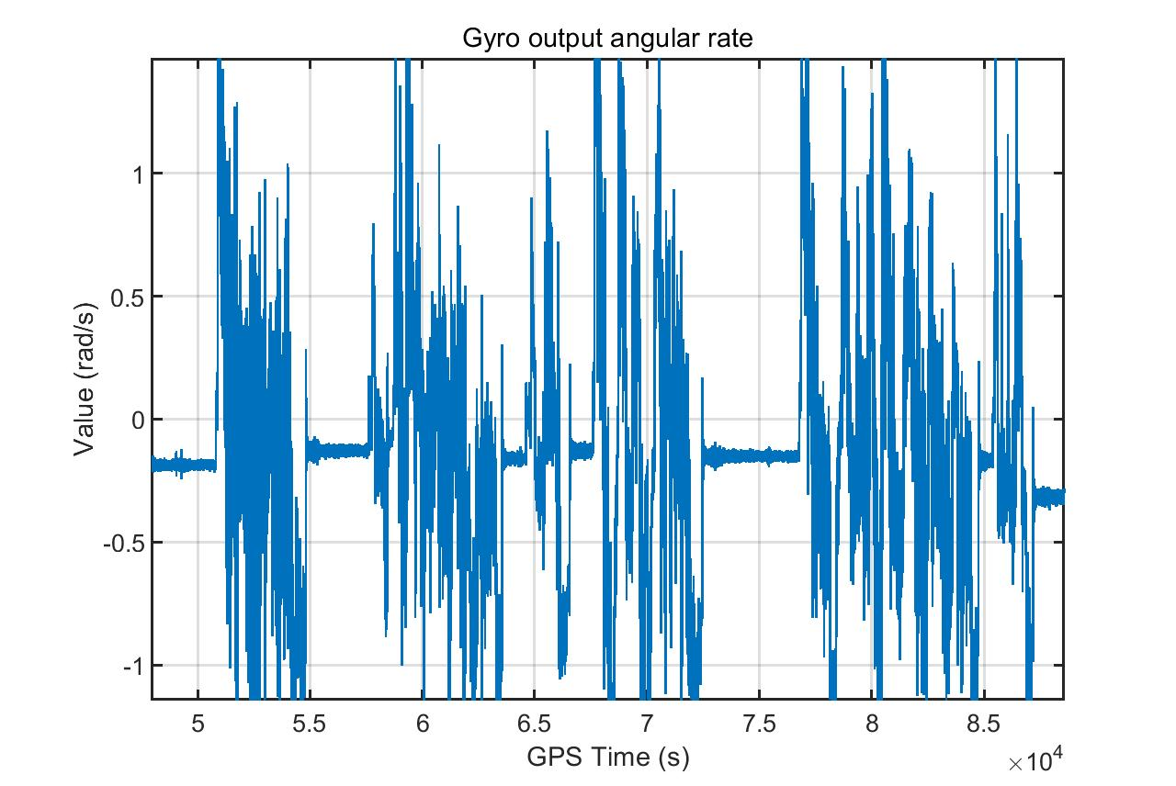

3.3 Zero angular rate update
The measurement matrix is:
$$H_{ZA,k}=\left(\begin{aligned}&0_{3} &&0_{3} &&0_{3} &&0_{3} &&−I_{3} &&0\end{aligned}\right)$$
The measurement innovations of gyro is:
$$δz_{b_{g},k}^{−}=0−b_{g}$$
Bias always exists in the INS, when the car is static, the gyro values should be zeros. In this time, the gyro measurements are available, and the Kalman filter can predict bias completely as above.
Notes:
LC_KF_config.ZARU_DGrySD=0.00050;

Slide 23
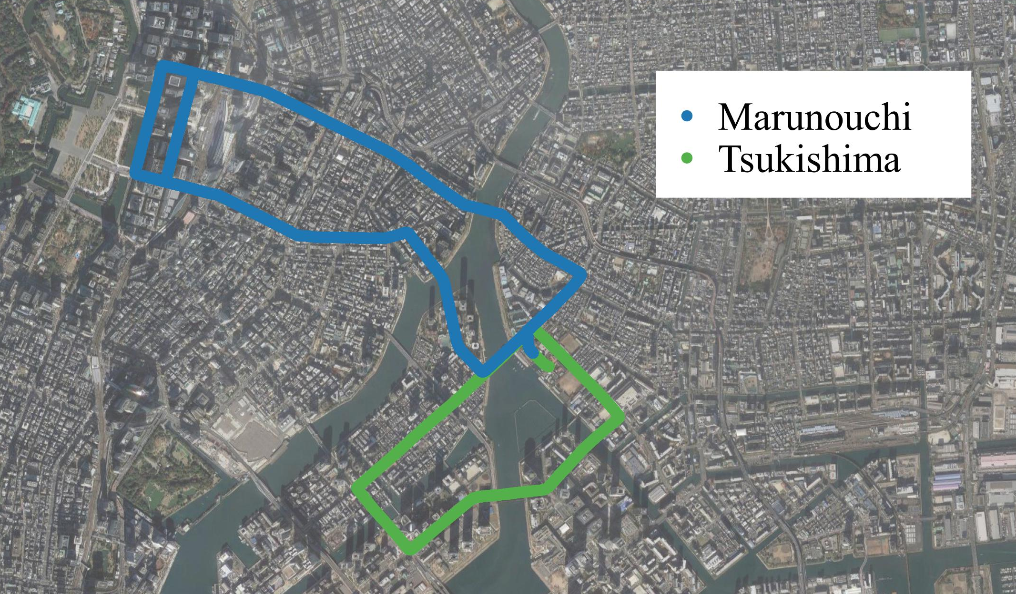
4. Experiment and result
Two portions were selected, as considered more relevant for the objective of the tests, for each dataset tested twice:
In Tsukishima, some places the GNSS signal is poor, but the environment isn’t always challengeable;
In Marunouchi, there are many tall buildings and it is hard to receive continuous GNSS signals. Also, it has one of the largest railway station, there are many overhead bridge, limiting the number of the satellites in view. It is a typical urban canyon environment.

Slide 24
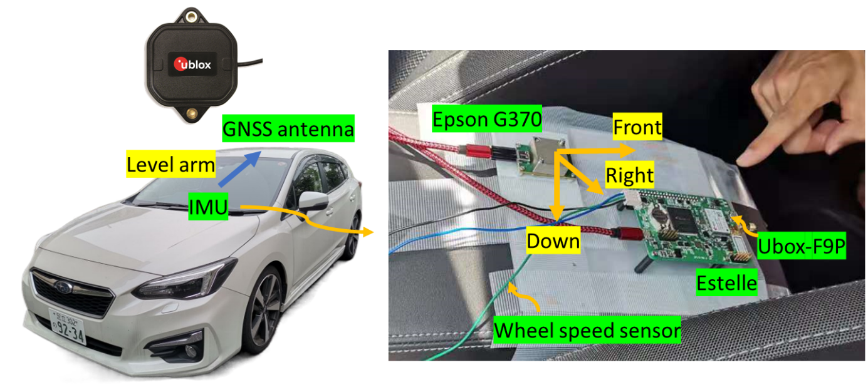
4. Experiment and result
Hardware list and setting:
Equipment | Output | Frequency | Note
Ublox-F9P | GNSS measurements | 5 Hz | Integrated with Estelle, synchronize the clock of sensors
Epson G370 | Gyro and acceleration | 50 Hz | Be used in Tsukishima 1st test and Marunouchi 2nd test
Estelle | Wheel speed sensor, temperature, air pressure | 50 Hz | Be used in Tsukishima 2nd test and Marunouchi 1st test
poslv | Position | 200 Hz
Notes:
https://global.epson.com/products_and_drivers/sensing_system/imu/g370/

Slide 25



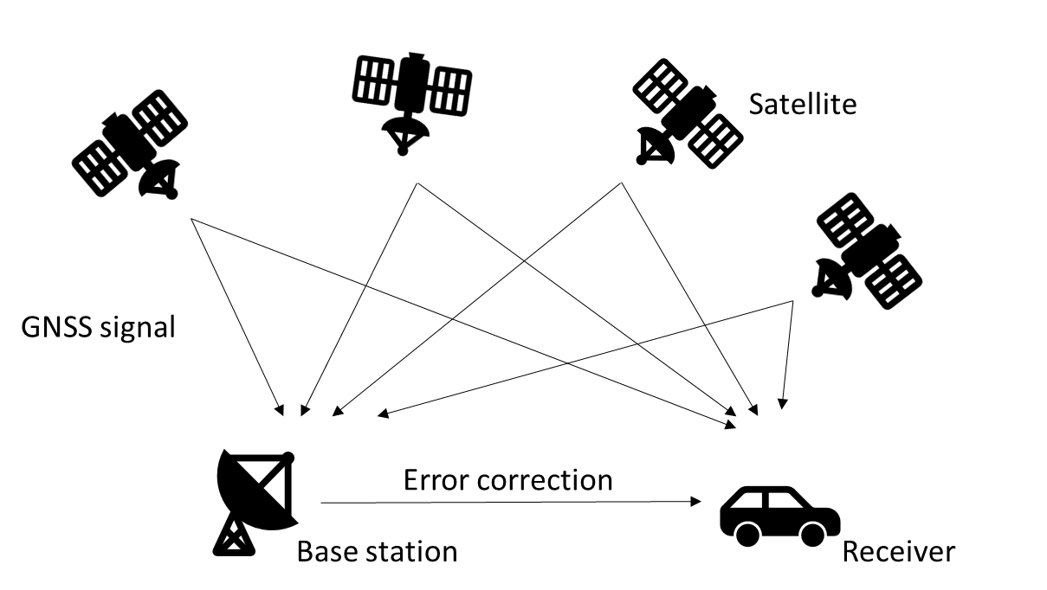

4. Experiment and result
The GNSS setting is as follows:
GNSS parameters setting
Satellites | GPS, QZSS, GALILEO and BDS
Elevation mask (degree) | 15
SNR mask (dBHz) | 35
GNSS measurements
Loosely coupled | RTK and DGNSS
Tightly coupled | DGNSS
Notes:
Noise Power Spectral Density

Slide 26
4. Experiment and result
The Kalman filter parameters are as follows:
Measurement noise | Measurement noise
LC | GNSS positioning noise (m) | 3e-2
 | GNSS velocity noise (m/s) | 1e-3
TC | GNSS pseudo range noise (m) | 1
 | GNSS pseudo range rate noise (m/s) | 6e-3
Multi-sensor | WSS+YAW (m) | 0.1
Multi-sensor | Zero angular rate (rad/s) | 5e-4
System noise | System noise
Gyro bias Instability (deg/hour) | Loosely coupled | 0.8
Acceleration bias Instability (uG) | Tightly coupled | 12
Acceleration velocity random walk (m/sec/hour^0.5) |  | 0.025
Gyro angular random walk (deg/hour^0.5) |  | 0.06
Receiver clock frequency-drift PSD (m^2/s^3) |  | 1
Receiver clock phase-drift PSD (m^2/s) |  | 1
Kalman filter initial setting
Initial attitude uncertainty (deg) | 20
Initial velocity uncertainty (m/s) | 0.1
Initial position uncertainty (m) | 10
Initial acceleration bias uncertainty (uG) | 1e-4
Initial gyro bias uncertainty (deg/hour) | 10
Initial clock offset uncertainty (m) | 10
Initial clock drift uncertainty (m/s) | 0.1
Notes:
Noise Power Spectral Density
https://global.epson.com/products_and_drivers/sensing_system/assets/pdf/m-g370pd_briefsheet_e_rev20201007.pdf

Slide 27
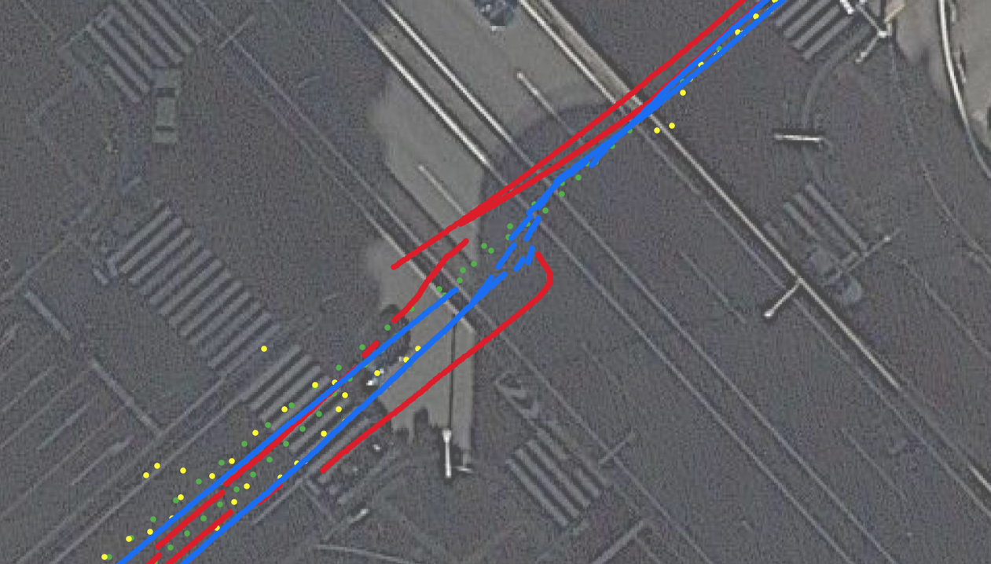
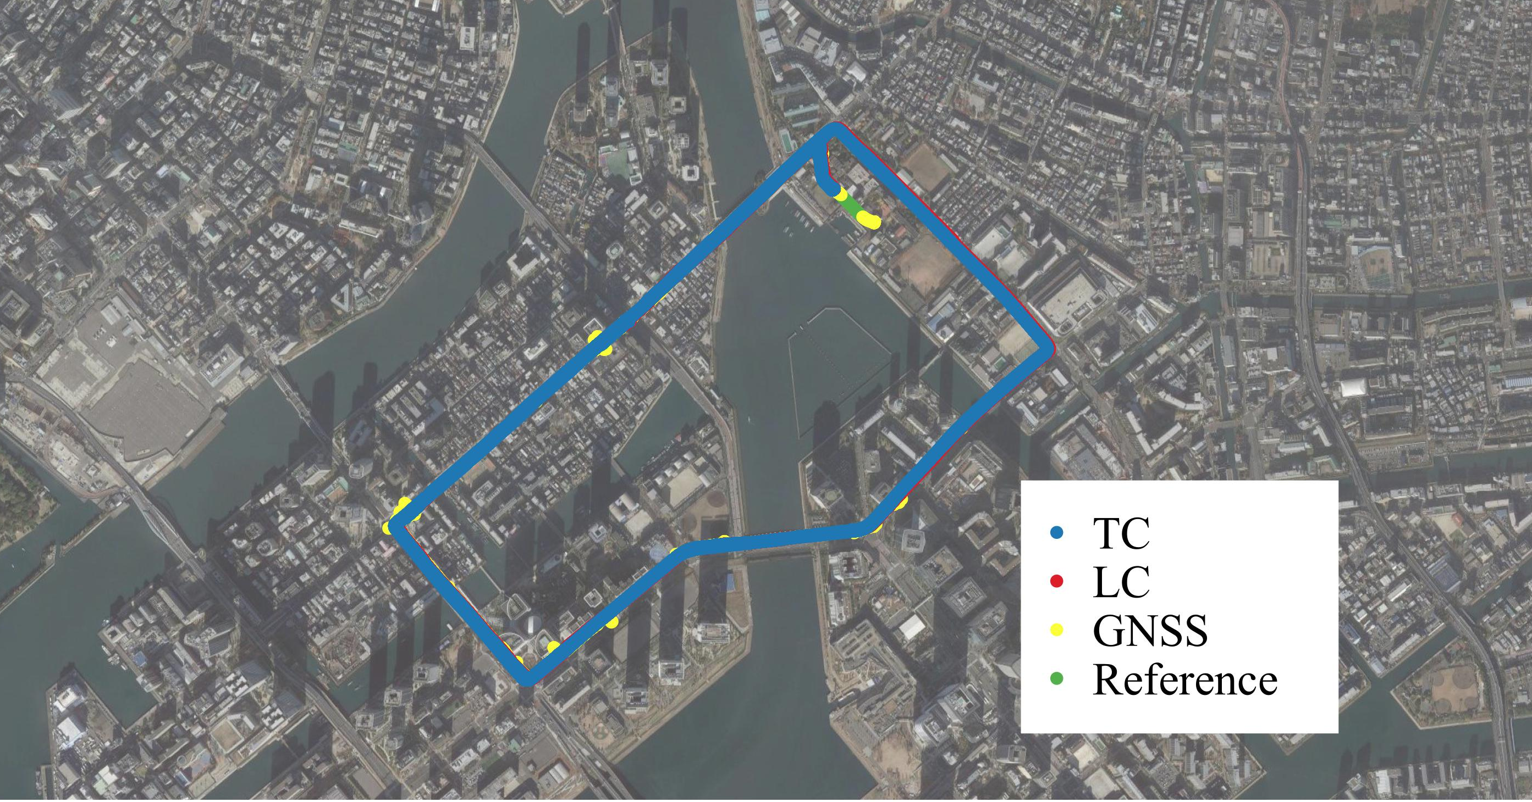
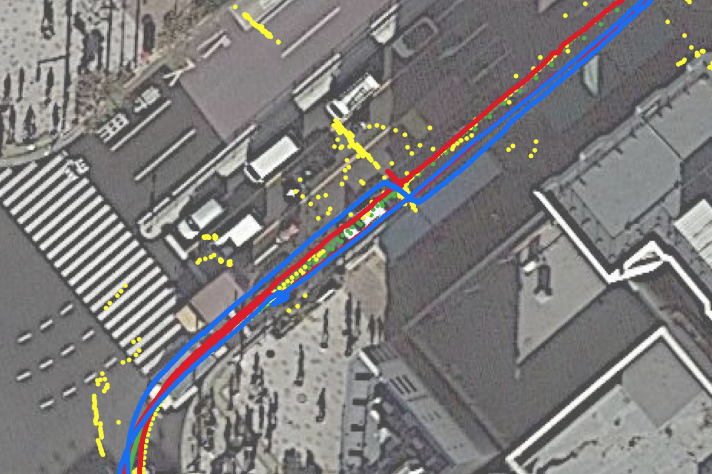
4.1 Tsukishima result
In Tsukishima result:
When the car under the viaduct, no GNSS signal, the TC error is smaller than the LC error, the TC attitude estimation is better than LC;
In multi-path effect, due to the GNSS velocity and pseudorange rate measurements, both LC and TC have stable positioning result;
LC position measurement using RTK fix and float solutions, so the TC mean error is lager than LC.
Note: GNSS means RTK fix solution and float solution
Notes:
GNSS means RTK fix solution and float solution

Slide 28
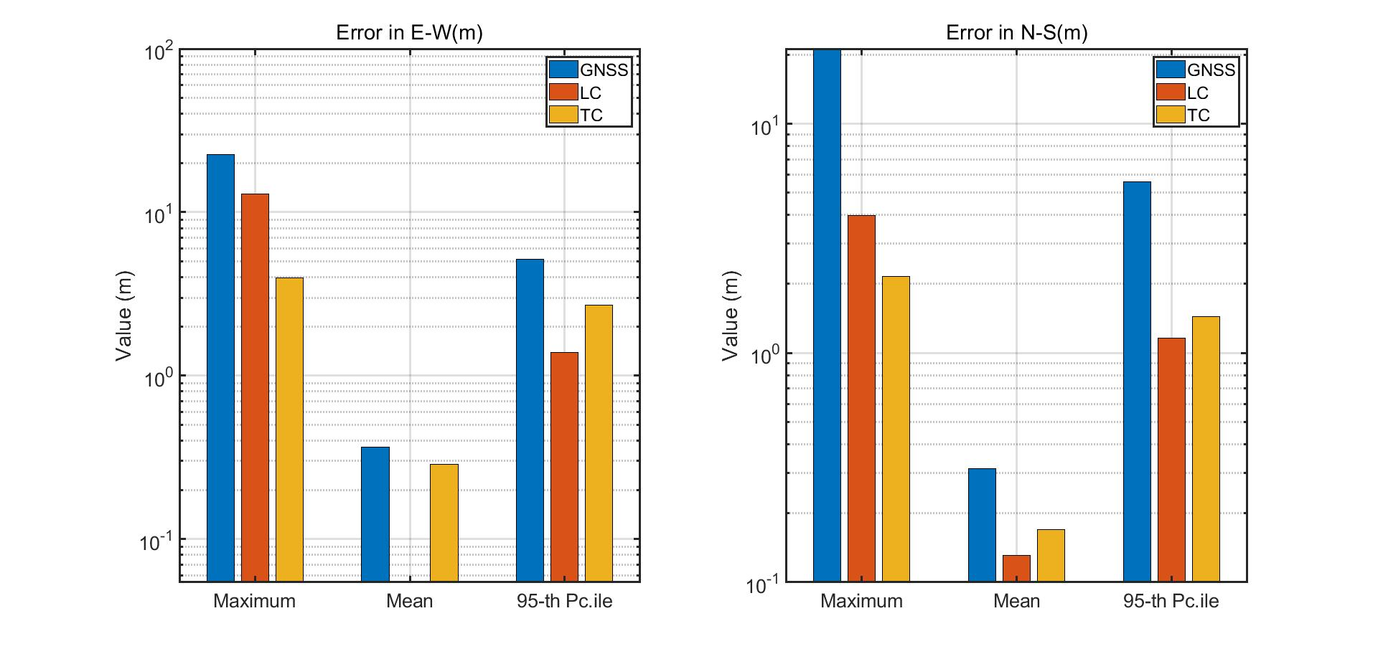
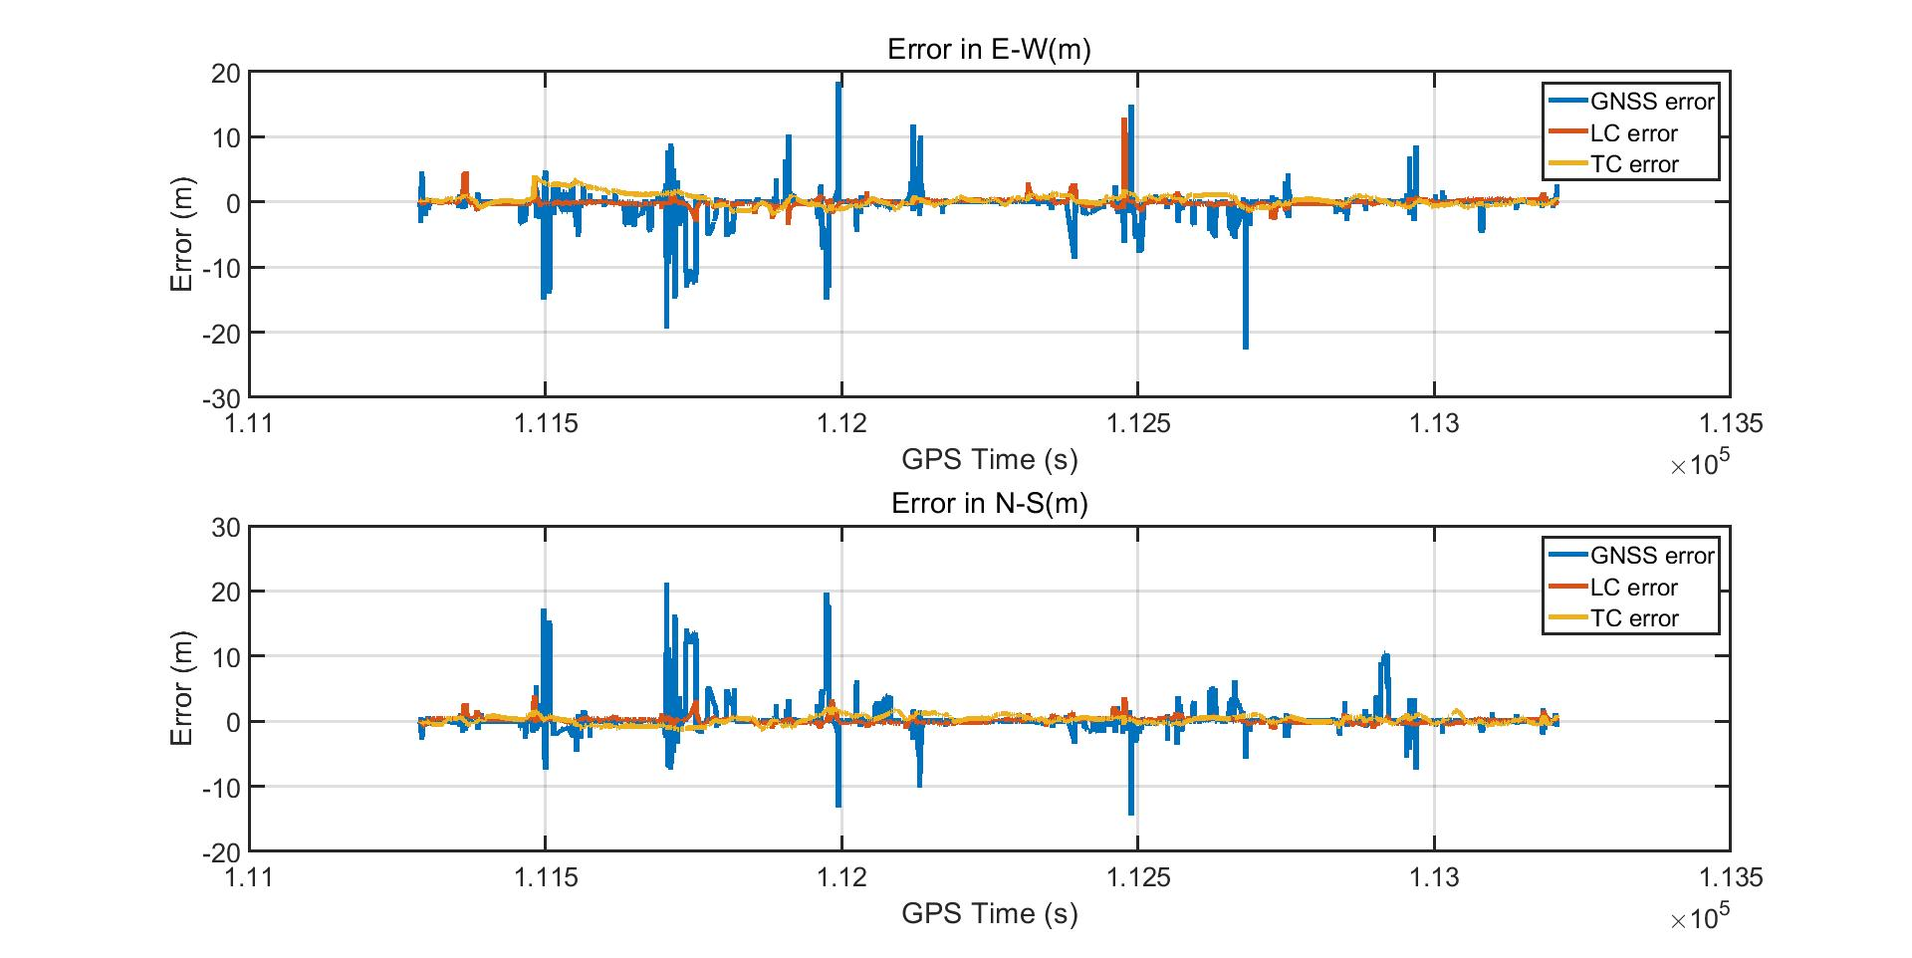
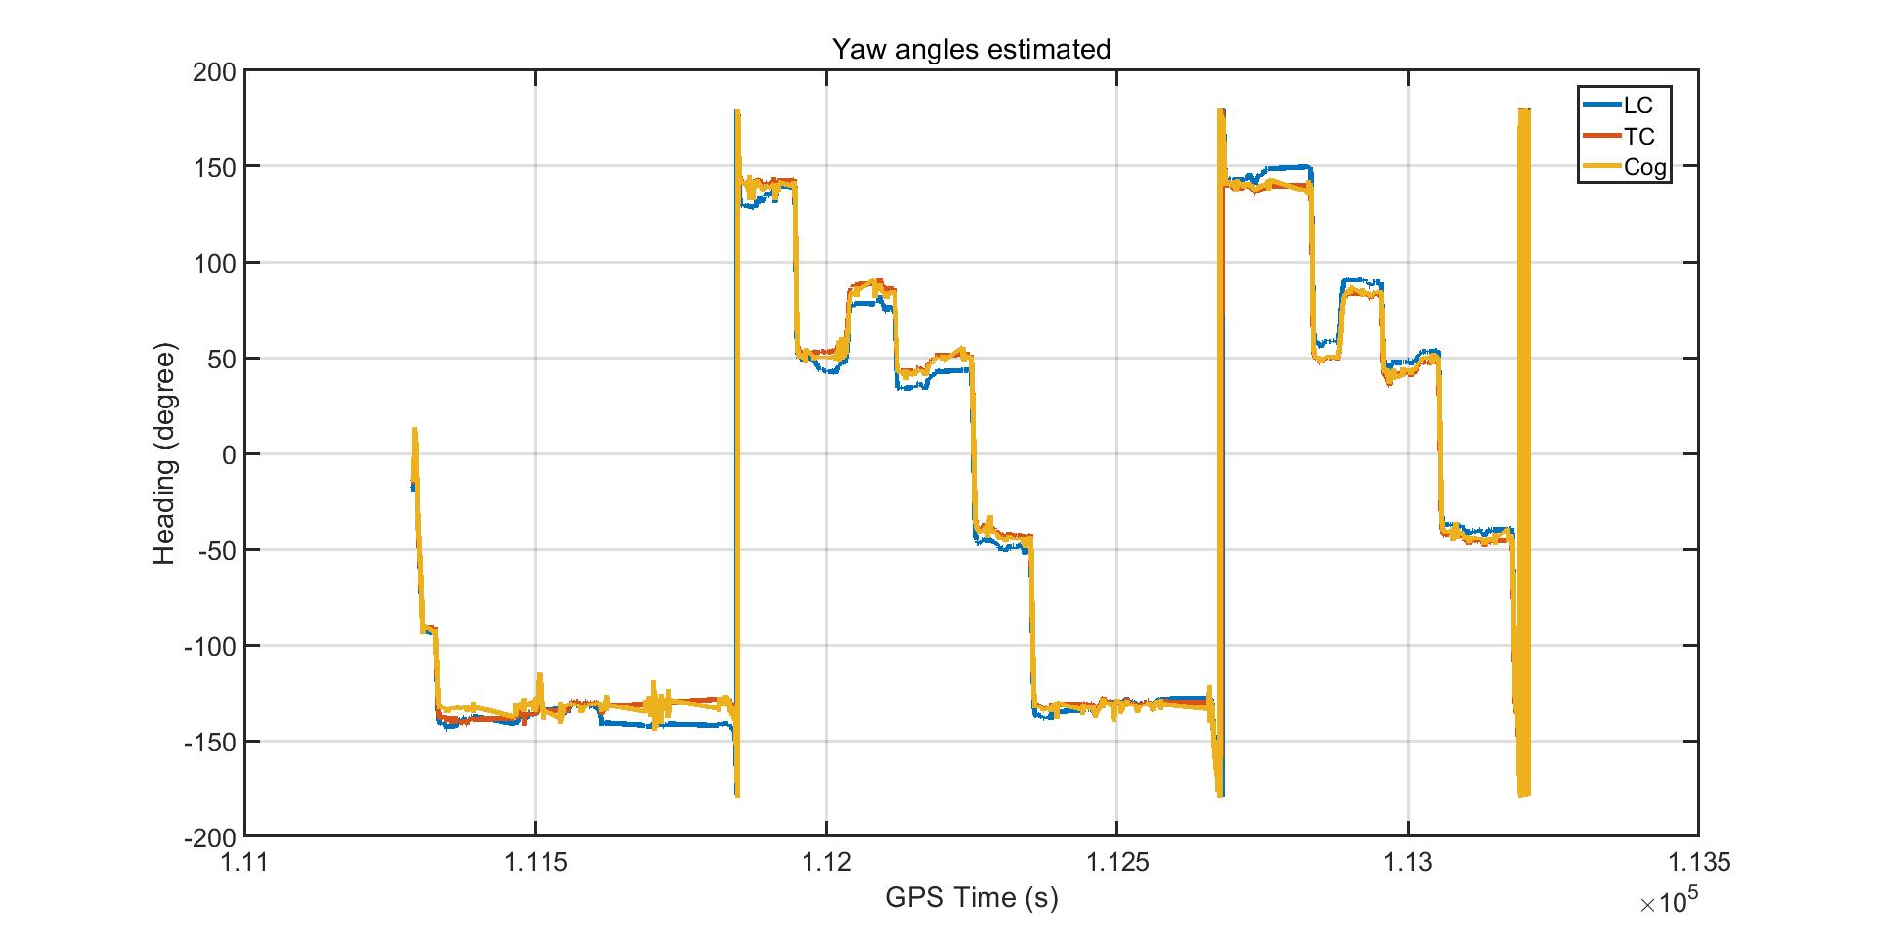
4.1 Tsukishima result 1st
1
3
2
Unit (m) | Max-E | Max-N | Mean-E | Mean-N | 95%-E | 95%-N
GNSS | 22.6471 | 21.2237 | 0.3653 | 0.3127 | 5.1651 | 5.5614
LC | 12.9120 | 3.9714 | 0.0544 | 0.1307 | 1.3885 | 1.1613
TC | 3.9694 | 2.1577 | 0.2866 | 0.1700 | 2.6873 | 1.4457
Notes:
FIX 70%
GNSS means RTK fix solution and float solution
95 Percentile

Slide 29
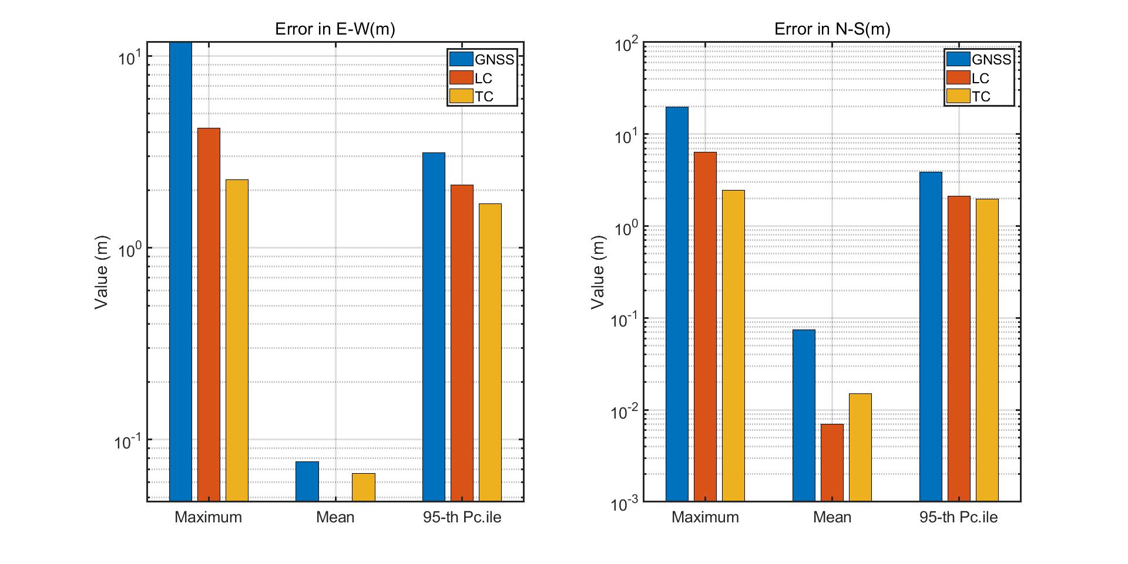
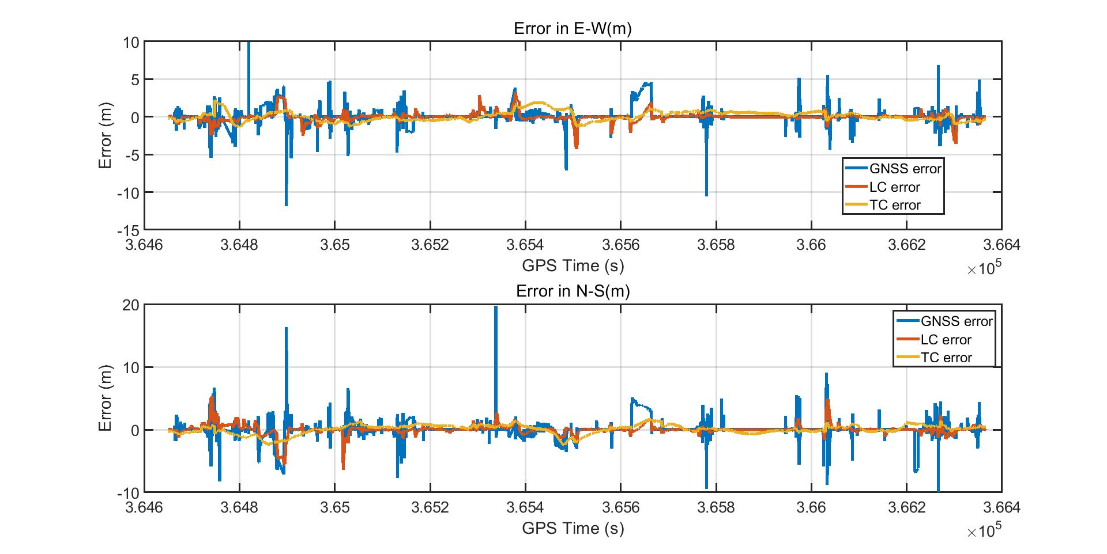
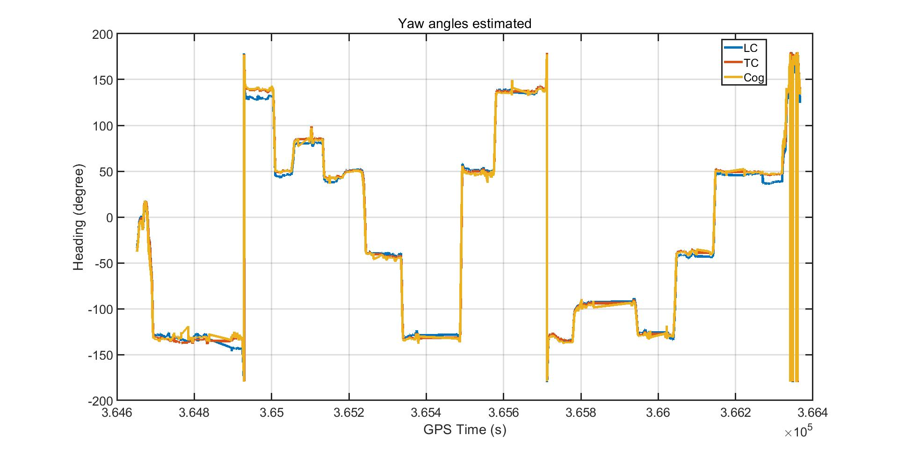
4.1 Tsukishima result 2nd
1
3
2
Unit (m) | Max-E | Max-N | Mean-E | Mean-N | 95%-E | 95%-N
GNSS | 11.7968 | 19.6548 | 0.0767 | 0.0739 | 3.1382 | 3.8893
LC | 4.2219 | 6.3466 | 0.0474 | 0.0070 | 2.1314 | 2.1126
TC | 2.2633 | 2.4547 | 0.0669 | 0.0151 | 1.6963 | 1.9741
Notes:
FIX 81.7

Slide 30
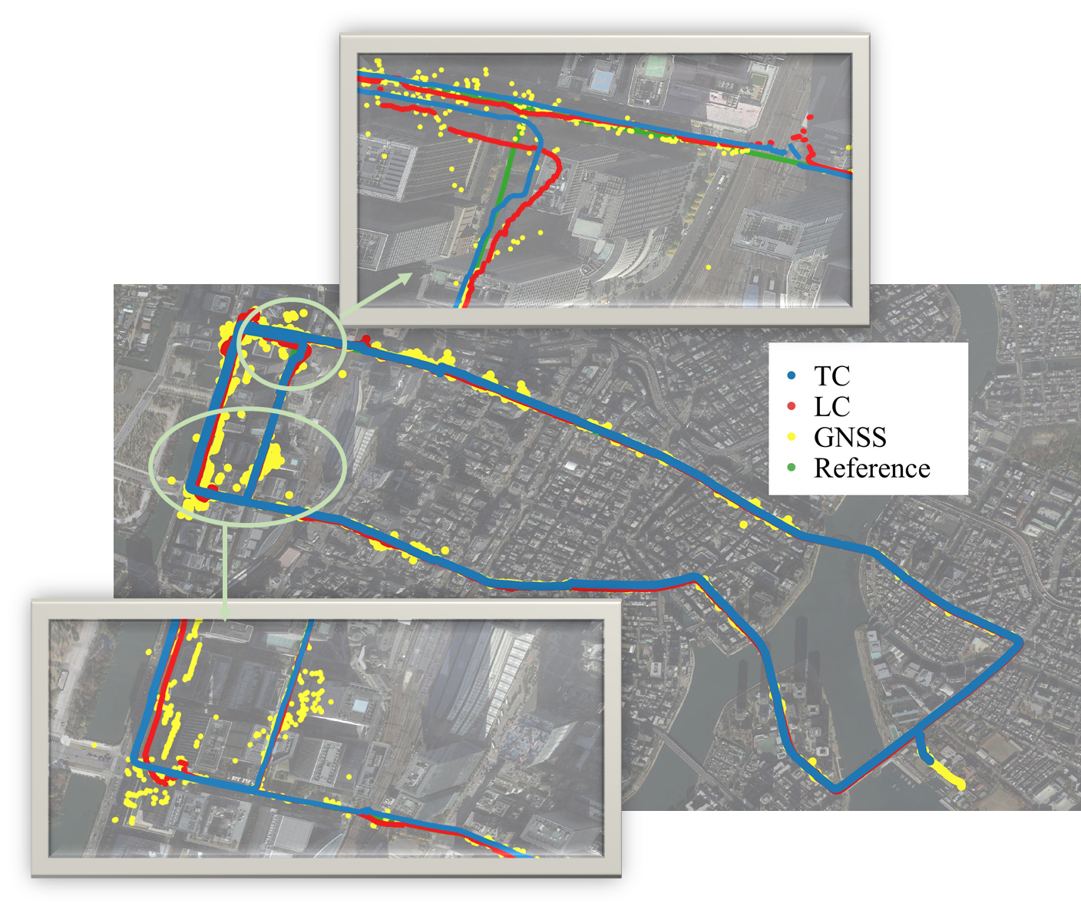
4.2 Result of Marunouchi
In Marunouchi 1st result:
In multi-path effect is strong in the left side of the figure, the GNSS signal is not continues and the error is huge.
LC heavily dependents on on the GNSS position and velocity, it is hard for LC to give accurate position here;
For TC, it can provide more measurements than LC in urban canyon environment, so the error is smaller than LC.
Notes:
https://global.epson.com/products_and_drivers/sensing_system/imu/g370/

Slide 31
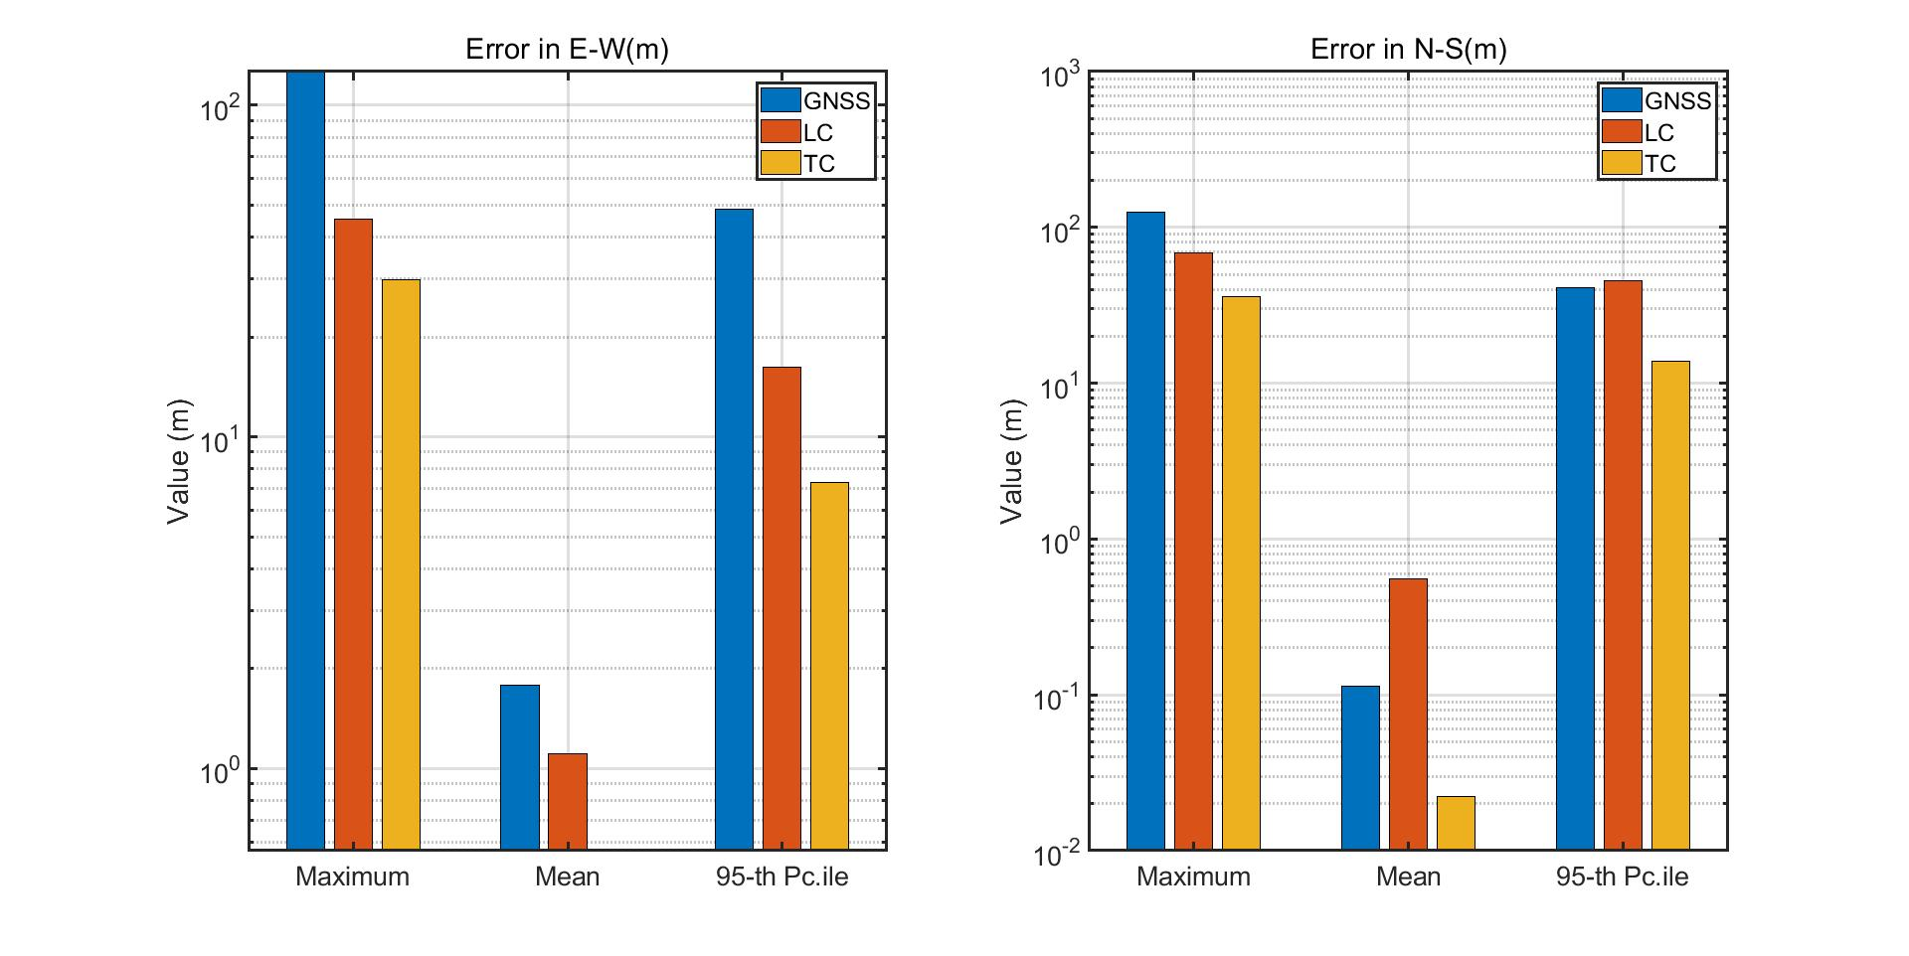
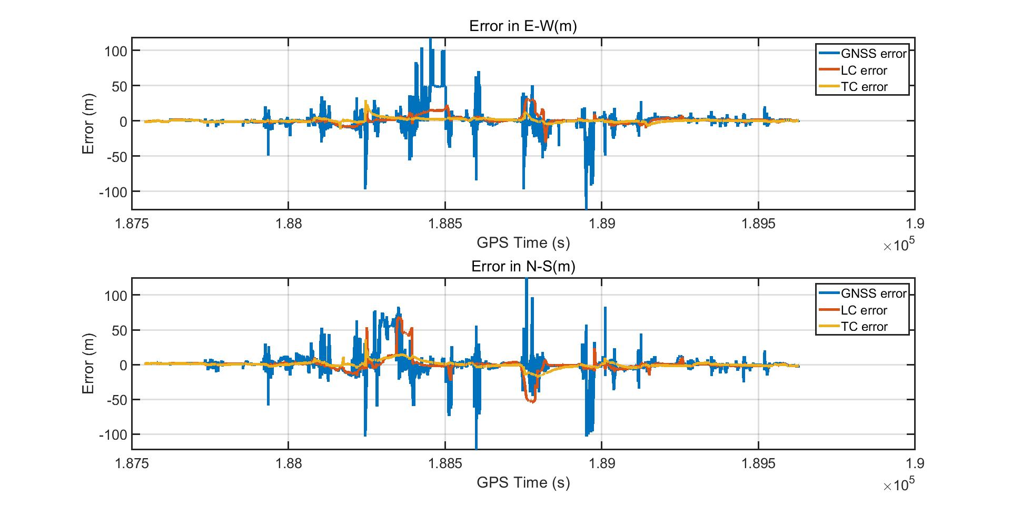
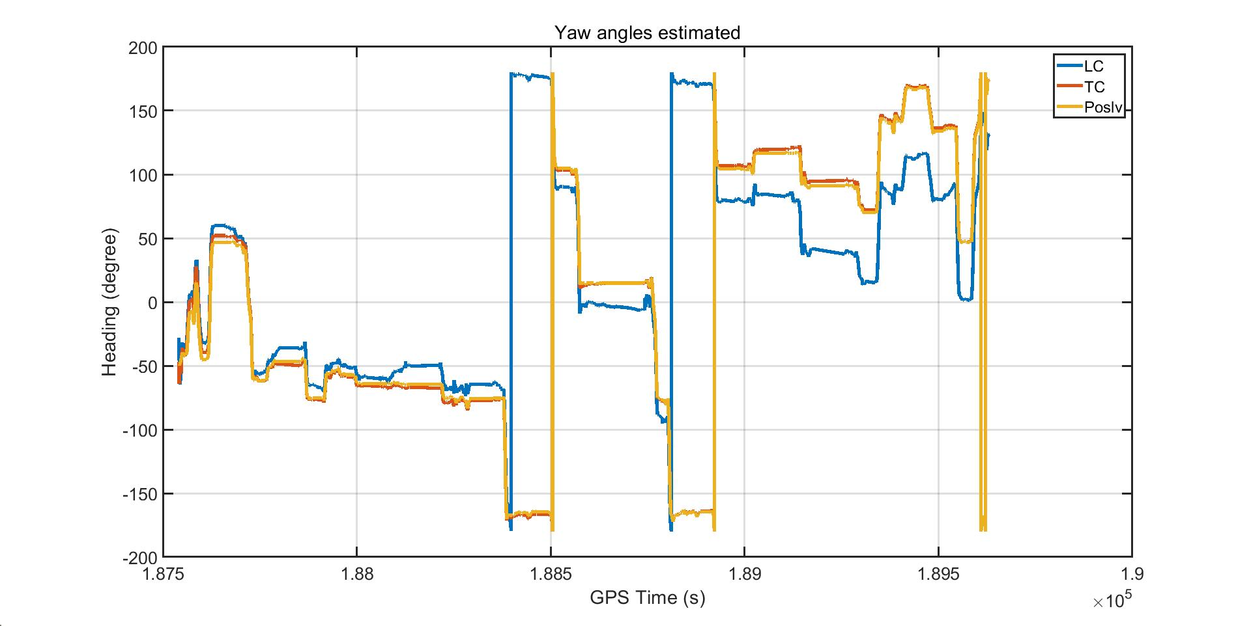
4.2 Result of Marunouchi 1st
1
3
2
Unit (m) | Max-E | Max-N | Mean-E | Mean-N | 95%-E | 95%-N
GNSS | 126.1871 | 124.9765 | 1.7869 | 0.1131 | 48.5011 | 40.8056
LC | 45.1765 | 68.9323 | 1.1100 | 0.5589 | 16.2394 | 45.2281
TC | 29.6913 | 36.1436 | 0.5658 | 0.0224 | 7.2646 | 13.8202
Notes:
https://global.epson.com/products_and_drivers/sensing_system/imu/g370/

Slide 32
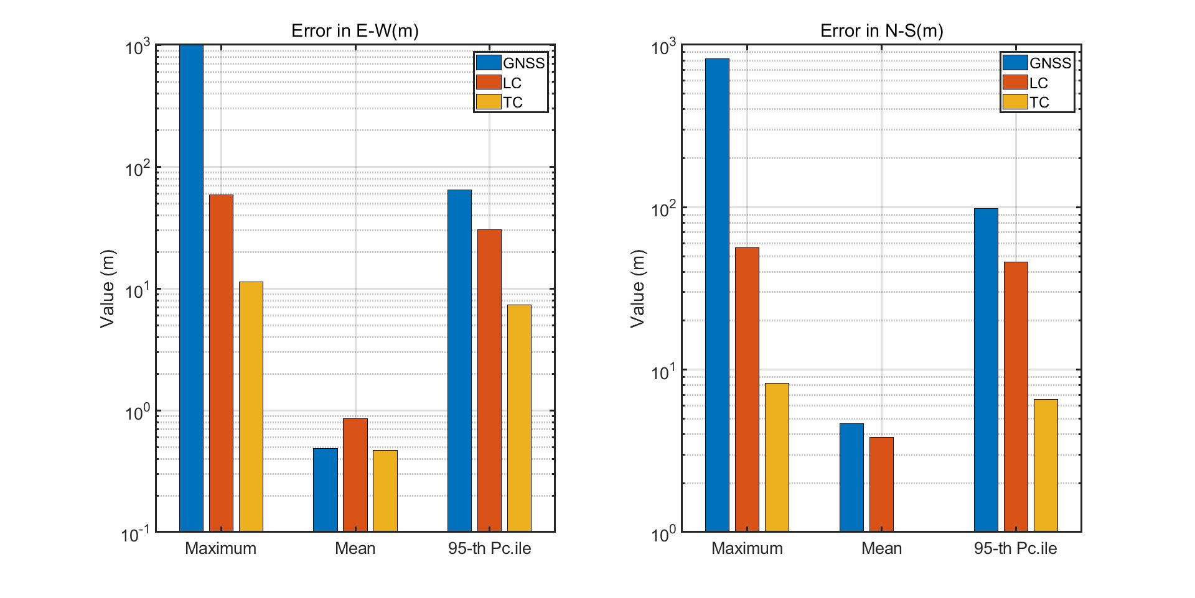

4.2 Result of Marunouchi 2nd
1
3
2
Unit (m) | Max-E | Max-N | Mean-E | Mean-N | 95%-E | 95%-N
GNSS | 1003.853 | 820.0854 | 0.4863 | 4.6508 | 64.6970 | 97.8188
LC | 59.0915 | 56.4772 | 0.8582 | 3.8423 | 30.5077 | 45.9571
TC | 11.3592 | 8.2782 | 0.4679 | 1.0031 | 7.3340 | 6.5890
Notes:
https://global.epson.com/products_and_drivers/sensing_system/imu/g370/

Slide 33


4.4 Multi-sensor fusion result
Unit (m) | Max-E | Max-N | Mean-E | Mean-N | 95%-E | 95%-N
GNSS | 1003.853 | 820.0854 | 0.4863 | 4.6508 | 64.6970 | 97.8188
LC | 59.0915 | 56.4772 | 0.8582 | 3.8423 | 30.5077 | 45.9571
TC | 11.3592 | 8.2782 | 0.4679 | 1.0031 | 7.3340 | 6.5890
Multi-sensor | 9.6177 | 8.0312 | 0.4673 | 0.8318 | 6.1176 | 6.1178
In the result of Marunouchi, the Multi-sensor fusion result is from the TC position and WSS+YAW. The maximum error is reduced, and positioning accuracy is improved.
Notes:
1st 286230-286178
2nd 284813-284797

Slide 34
5. Summary
After serious of the vehicle data test and analyzed the results,
the conclusions are as follows:
In norm urban environment, LC mean error and 95th percentile are smaller than TC, maximum error is larger than TC;
In urban canyon conidiation, LC error is morse than TC;
LC is easier affected by GNSS error than TC;
The estimate yaw angle form LC is worse than TC;
Multi-sensor fusion can reduce the maximum error effectively.
In norm urban environment, TC result is stable than LC;
In urban canyon environment, TC is better than LC;
Notes:
https://global.epson.com/products_and_drivers/sensing_system/imu/g370/

Slide 35
5. Summary
For this master thesis there are several shortages:
The IMU bias affected by the temperature, but here is no temperature compensate;
The initial attitude ROLL and PITCH are set as zeros, the attitude error is exist;
The loosely coupled without anti-error Kalman filter, so the error is affected by the GNSS easily;
For the future research:
The program was written by MATLAB, it is necessary to replace it by C/C++;
Carrier phase will be included in TC to improve the positioning accuracy;
Multi-sensor in tightly coupled, which include GNSS compass;
Notes:
https://global.epson.com/products_and_drivers/sensing_system/imu/g370/

Slide 36

Thank you for your watching!
Notes:
All models are wrong, but some are useful.

